Slide 1
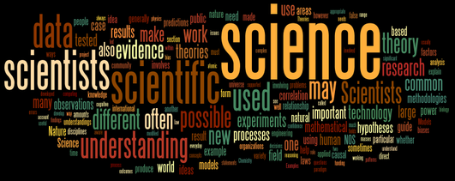
The Nature of Science

Slide 2
What is Science?
Science – Not Just for Scientists
  Scientists observe the world, but so do everyday people
  The Nature of Science
    Goal of science is to understand the world around us
      Scientists use special methods
      Scientists use facts to propose explanations
      Scientists perform experiments to test explanations

Slide 3
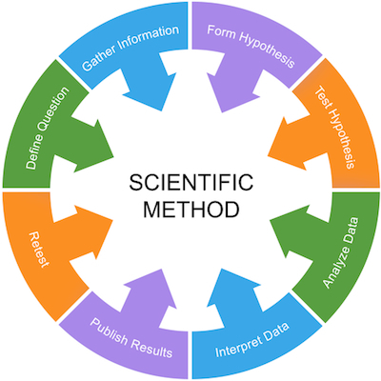
The Scientific Method – A Way of Problem Solving
Science has a specific way of solving problems
The scientific method is a systematic approach to problem solving
Basic steps of the Scientific Method
  Stating the Problem
  Gathering Information
  Forming a Hypothesis
  Testing the Hypothesis
  Recording and Analyzing Data
  Stating a Conclusion
  Repeating the Work

Slide 4


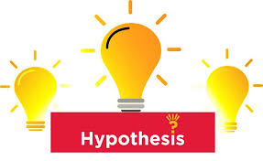
The Scientific Method – A Way of Problem Solving
Science has a specific way of solving problems
The scientific method is a systematic approach to problem solving
Basic steps of the Scientific Method
  Stating the Problem
    Asking a question based on observation
    Must be testable
  Gathering Information
    Researching all there is to know about the topic
  Forming a Hypothesis
    Propose a prediction or possible solution

Slide 5
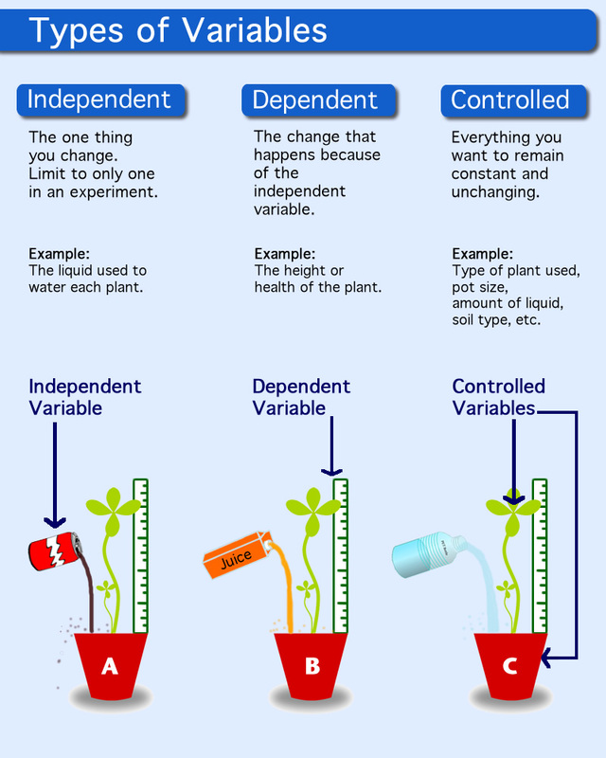
The Scientific Method – A Way of Problem Solving
  Testing the Hypothesis
    Plan an Experiment
      Determine materials (what will you use)
      Determine procedures (how will you use it)
      Determine variables
        Independent (test) variable
        Dependent (outcome) variable
        Constant variable Experiment (test)
      must be a controlled test (change only 1 variable)
      must have multiple trials
      Observational study, Experiments, Models

Slide 6
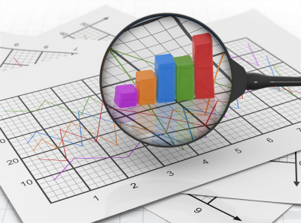
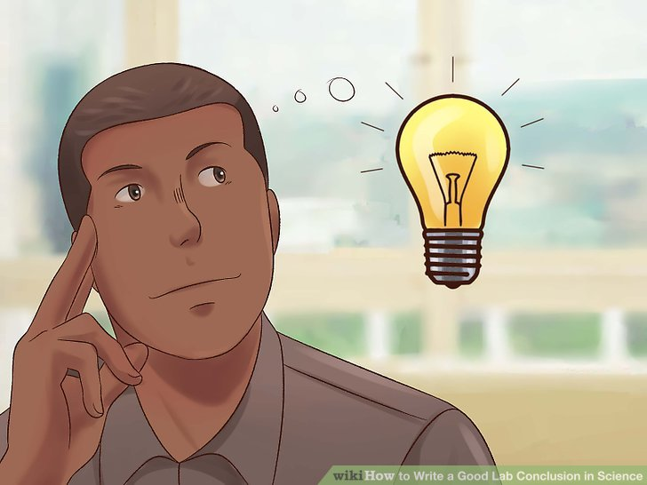
The Scientific Method – A Way of Problem Solving
  Recording and Analyzing Data
    Collect data (can be qualitative = words, or quantitative = numbers)
    Put data into a chart or table
    Graph data (bar graph line graph, circle graph)
      Look for patterns, trends,
  Stating a Conclusion
    What does the data tell you?
    Data will support the hypothesis or fail to support the hypothesis
  Repeating the Work
    Replicating the test again
    Look for errors
    Check validity (accuracy)
    Check reliability (do others get same results)

Slide 7
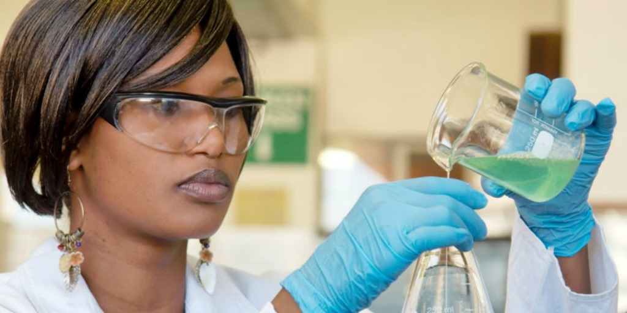
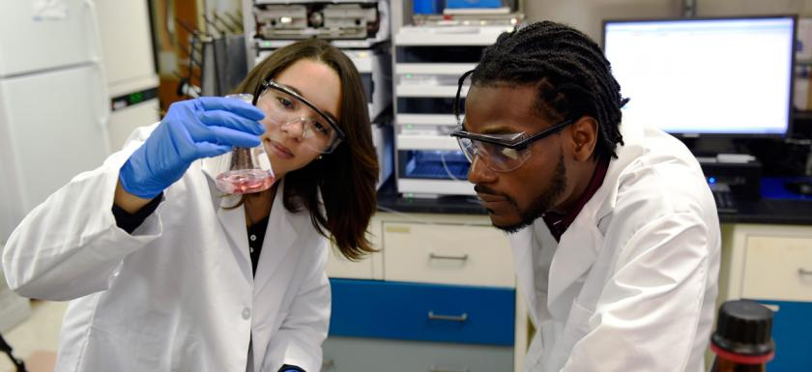
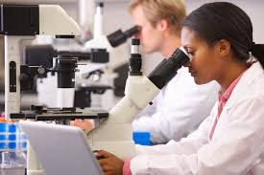
Characteristics of Science
Follows the evidence wherever it leads
Embraces criticism
Uses precise terminology with clear definitions
Claims are conservative and tentative
Properly considers all evidence and arguments
Uses rigorous and repeatable methods
Engages with peers and community
Follows careful and valid logic
Changes with new evidence

Slide 8
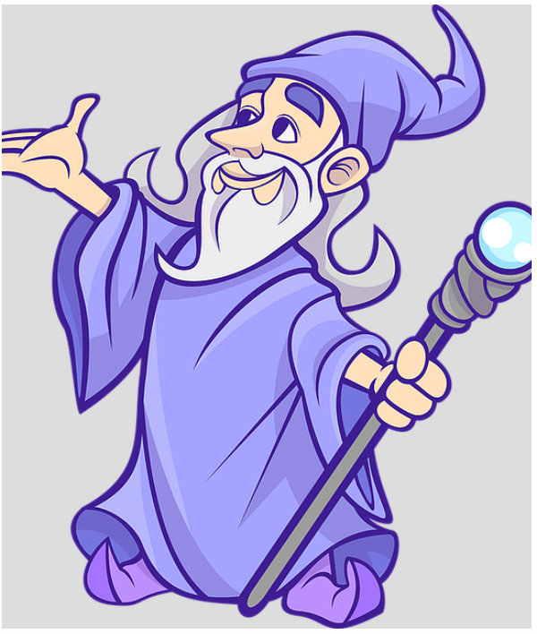
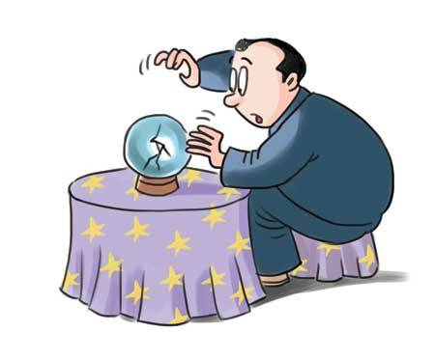
Pseudoscience - “Pseudo“ meaning false or fake
Starts with a conclusion, then works backwards to confirm
Hostile to criticism
Uses vague jargon to confuse of evade
Grandiose claims that go beyond evidence
Cherry picks only favorable evidence, relies on testimonials or weak evidence
Uses flawed methods with unrepeatable results
Lone mavericks working in isolation
Uses inconsistent and invalid logic
Dogmatic and unyielding

Slide 9
Theories & Laws
Scientific theory
  Explanation of how or why an event occurred (accepted by scientists as true)
  Based on repeated observations and tests
  Can be rejected or modified if evidence disproves the theory
  A theory will never become a law
  Ex. Kinetic Molecular Theory, Cell Theory, Theory of Evolution
Scientific law
  States an event will occur (accepted by scientists as true)
  Does not explain why or how
  Can be rejected or modified if evidence disproves the law
  A law does not become a theory
  Ex. Laws of Motion, Law of Conservation of Energy, Law of Universal Gravitation

Slide 10
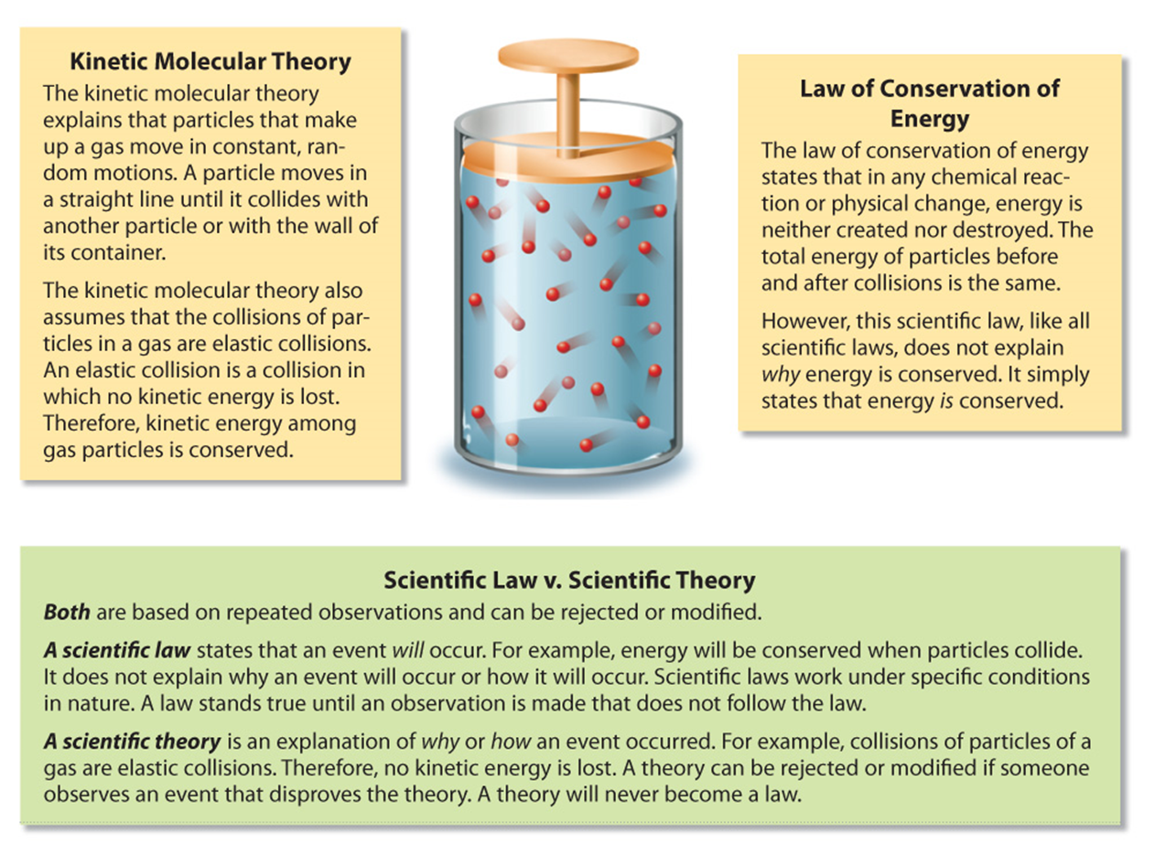

Slide 11
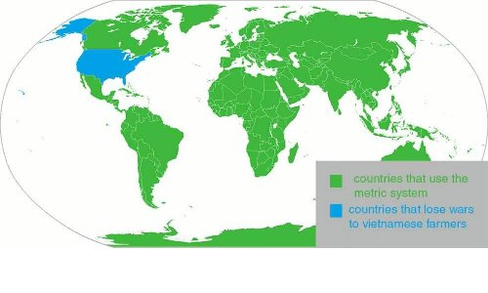
Measurement and Science
The Metric System (SI)
  System of Measurement used in Science (standard)
  Eliminates confusion and helps in communication
  Nearly all of the world uses it

Slide 12
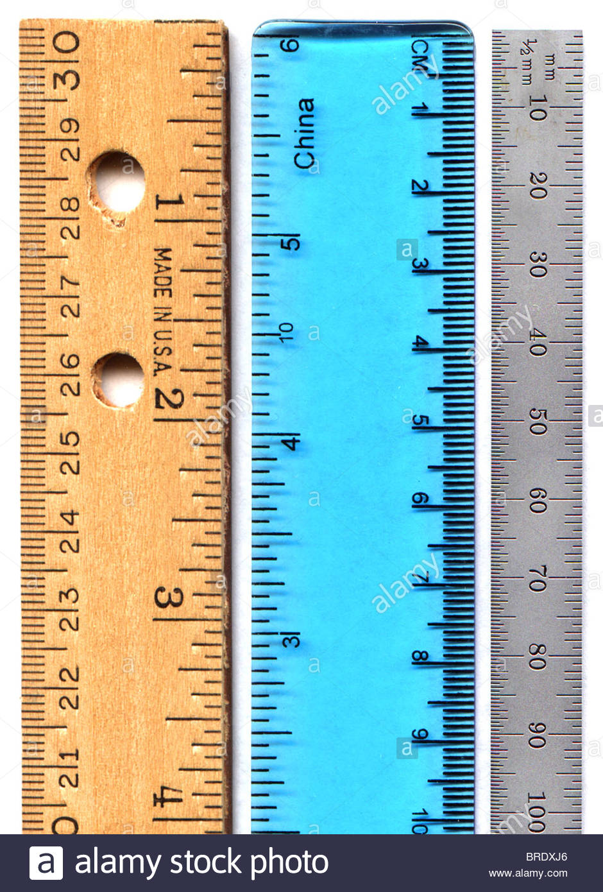
Measurement and Science
Measuring Length
  Kilometers, Meters, Centimeters, Millieters
  Use a metric ruler
  Start at zero
  Centimeter – every line equals 0.1 cm
  Millimeter – every line equals 1 millimeter

Slide 13
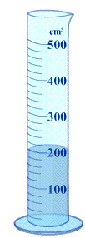
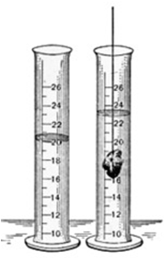
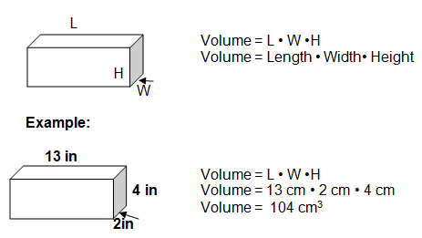
Measurement and Science
Measuring Volume
  Kiloliters, Liters, Centiliters, Milliliters
  Use a graduated cylinder if a liquid
  Use a ruler if a rectangular prism
  Use water displacement if irregular solid

Slide 14

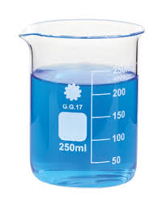
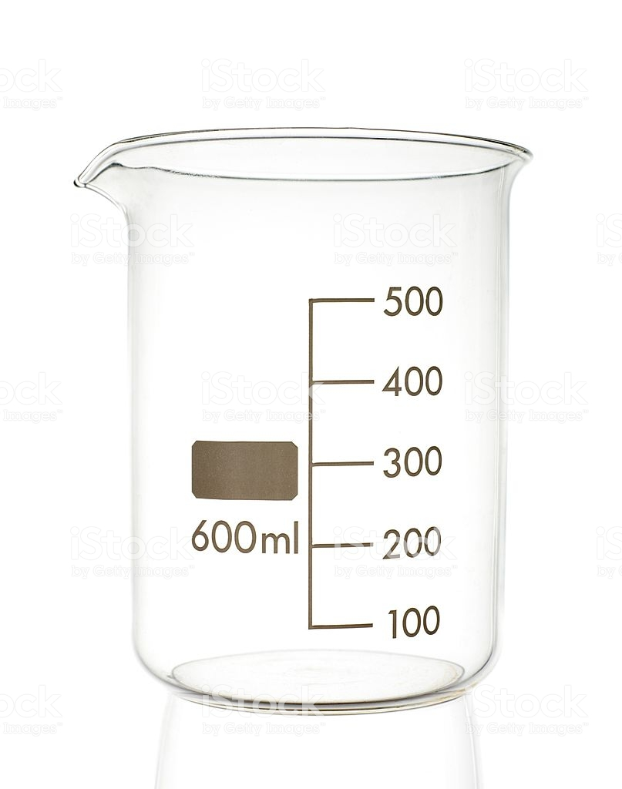

Measurement and Science
Measuring Mass
Kilograms, Grams, Centigrams, Milligrams
Use a digital balance
If item is in a container,
subtract empty container from full
$$−$$

Slide 15
Measurement and Science
SI uses standards of measurement called base units
Quantity | Base Unit
Length | meter
Volume | liter
Mass | gram
Time | second

Slide 16
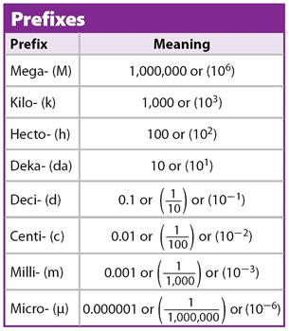
Measurement and Science
Units that are not base units are
made from base units
Based on multiples of ten
Factors of ten represented by
prefixes

Slide 17
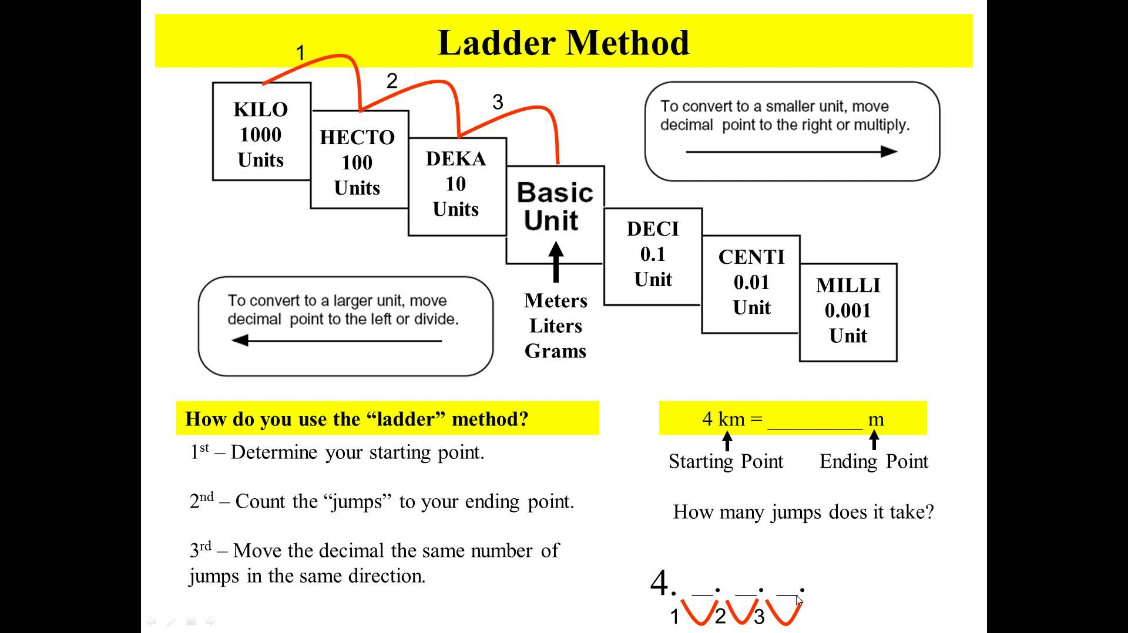
Measurement and Science
Converting between SI units
  Multiple or divide by a factor of ten
  Move decimal point

Slide 18
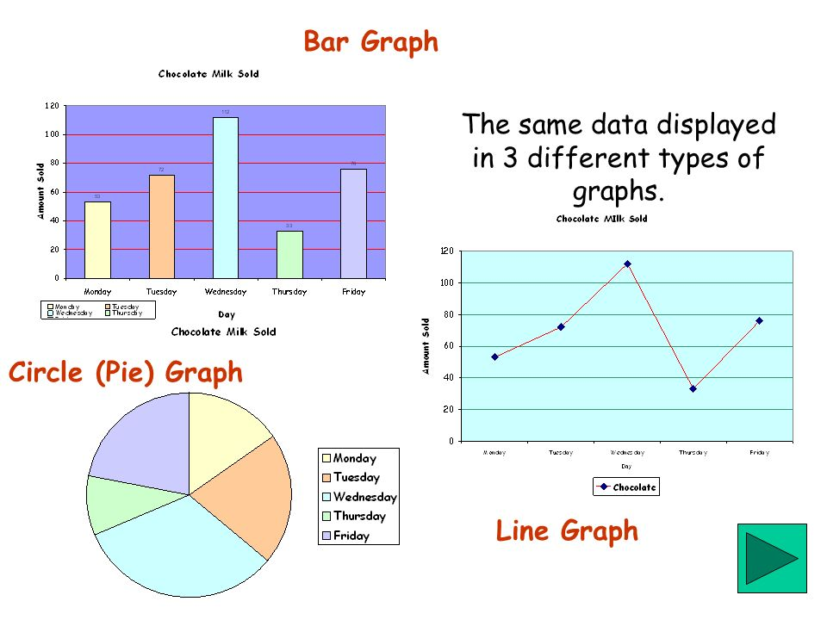
Graphing in Science
Graphs are a visual representation of data
There are many types of graphs

Slide 19
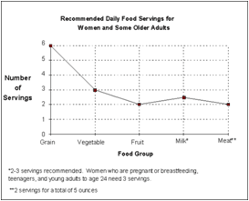
Graphing in Science
Line Graphs
usually changes over time
multiple lines on same graph
Constructing line graphs
X-axis = independent variable
Y-axis = dependent variable

Slide 20
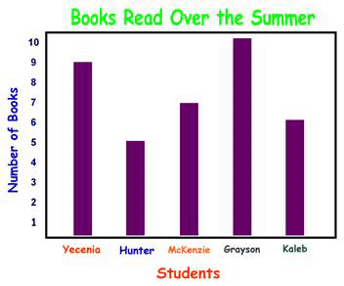
Graphing in Science
Bar Graphs
comparing information
x-axis = independent variable
y-axis = dependent variable

Slide 21
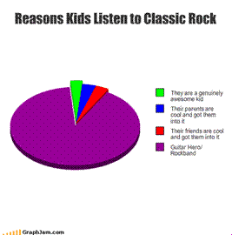
Graphing in Science
Circle Graphs (pie charts)
shows how fixed quantity is broken
into parts using percentages

